Slide 1
Exam Information
INTERNAL END OF YEAR EXAMS
Form Tutor will give out timetables with rooms and seat numbers
Parents will receive a letter containing all the exam dates.

Slide 2
Procedures and Rules – Part 1
Go to Registration first before the period 1 exam
Mobile phones fully SWITCHED OFF – not on silent
Left in bags, NEVER left in pockets
If you are caught with a mobile phone in your pocket during external GCSE/BTEC exams you will be DISQUALIFIED.
This is also the same for SMART watches - do not wear it

Slide 3
Procedures and Rules – Part 2
Bags must be left at the front of the row in which you are sitting
Letters at back of the room and numbers down the side
Sit at the desk with the correct name label
NO turning around, talking or communicating
Exam conditions apply from the moment the room is entered and until students have left the room.
Listen carefully to instructions given by the Invigilators.

Slide 4
Exam Preparation

Slide 5
Does your bedroom look like this?

Slide 6
Are there ‘beautiful’ distractions at home?

Slide 7
Preparation for GCSE
Preparation for next year – ‘DIRT’ / improve development
areas
Avoid ‘resitting’ before summer
Do I really have to Revise?

Slide 8
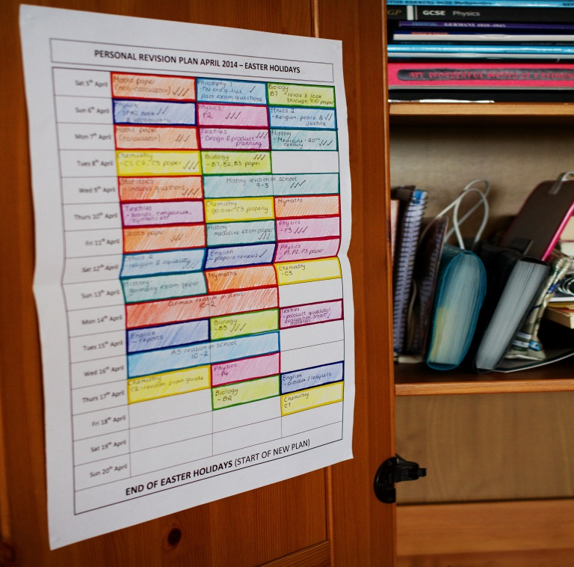
Find out the key topics from each subjects Plan out the topics into a revision timetable

Slide 9
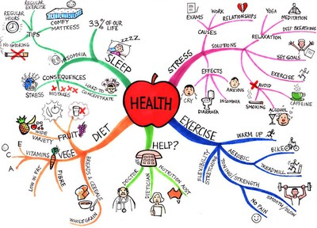
How do I revise? Active / Varied / Personal
Silly stories
Rhymes/songs
Memory Palace
Highlighters/colour
Teach someone else
Summarise
Read aloud
Record yourself/listen
Practise questions

Slide 10
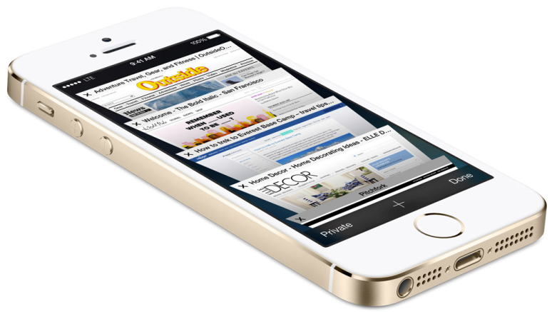
Managing devices – Benefits and Distractions?
Put it in another room
Turn it to silent
Turn to airplane mode
Check it during breaks

Slide 11
Make the most of the support available
Start now! Revise at half term!
Use the resources online, including the student area ‘Revision & study support’ and ‘Show My Homework’
Use the library
Monday-Thursday 8.15 - 4.45 / Friday 8.15 - 4.00.
Open at lunchtimes too!
Talk to staff if you need any further support!

Slide 12
Show My Homework Instructions for Logging in
Students have received a letter with the parent PIN.
Students can log in as a student using Office365
Username/email is in the format of :
windowslogonusername@student.lythamhigh.lancs.sch.uk
Reset by e mailing servicedesk@dataspire.co.uk or ICT technicians.

