Slide 1
What is effective revision?

Slide 2
Revision myth 1
Rereading notes and highlighting are effective revision strategies.
These revision strategies have been shown to be the most popular amongst students. Unfortunately, they are also very ineffective. Instead, students should be encouraged to use retrieval practice (regular testing from memory) and distributed practice (spacing out practice sessions over time).

Slide 3
Revision myth 2
Cramming is an effective revision strategy.
Although cramming is better than no revision at all, it is unlikely to lead to durable learning. Spacing revision over time and revisiting materials at regular intervals are far more successful techniques.

Slide 4
3 parts of exam success
Recall of information
Understanding the questions
Application of the information

Slide 5
Where will you revise? Not in front of the TV Lay out all the materials for each subject to save time It’s worth trying to sort the bedroom out. Get rid of clutter, have proper space to work At a table, preferably in a quiet place Come to a compromise on music Good revision needs to be active

Slide 6
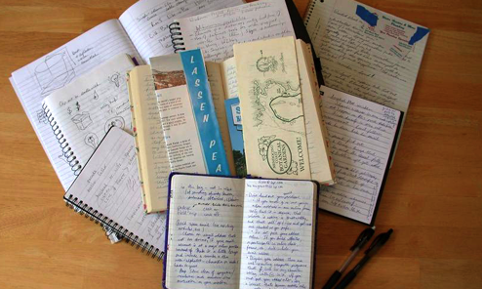
What should you have with you when revising? - Revision timetable - An up to date set of class notes - Any revision materials given out by departments - Revision Lists - Lists of exactly what is in each exam - Any Study Guides which have been bought (but you need to treat them with caution, check they are covering what is in your course. Teachers will be able to tell you which ones are the best and if they are needed.

Slide 7
USING PERSONAL DEVICES/COMPUTERS Personal devices can be useful tools when revising but many of our students have said that they are more of a distraction when they really need to focus. You will have access to many types of digital media which could interrupt a great revision session. The willpower to resist the urge to answer a text or a phone call will be very difficult. Answering texts or checking status updates could be saved as a break in the middle of a revision session.

Slide 8
How long should you revise for?
If you revise for 2 hours your memory works like this;
Concentration

Slide 9
How long should you revise for?
But if you revise for 2 hours in 30 minute blocks with 10 minute breaks it looks like this:
Concentration

Slide 10
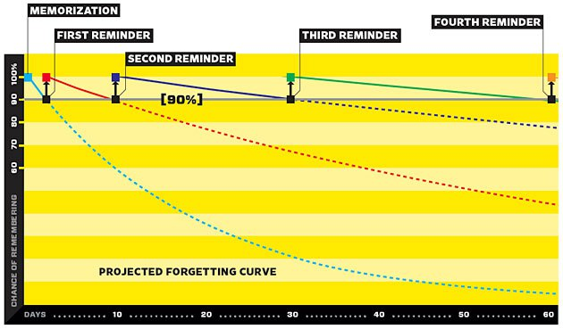
Spaced repetition
Spacing your retrieval practice over a number of days and weeks is far more advantageous than cramming it all into one revision session.

Slide 11
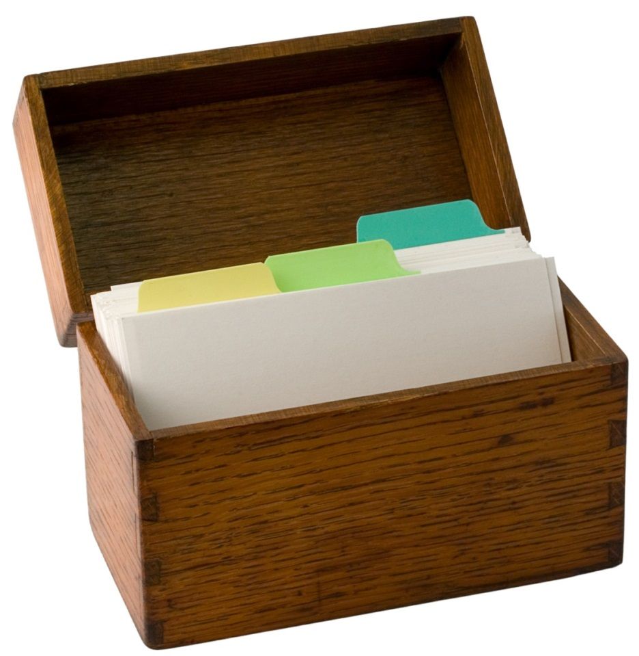
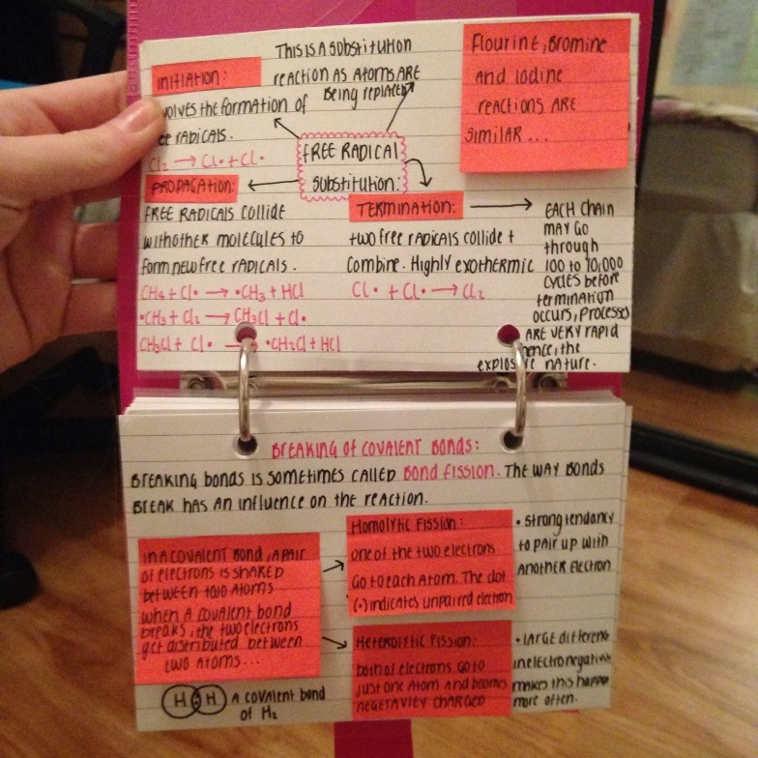
Index Cards
Each card should have the information from each module/topic you have studied.
Most revision then will be based on around 12 cards.
Make each card memorable.
How to make the perfect flash card

Slide 12
Choose your rewards during revision
After 1 hour of revision:
15 minutes of ……..

Slide 13
Year 7 – key word focus
Flash cards that have keyword definitions.
On the other side of each flash card write 3 questions that are linked to the keyword definitions.
Retrieval practice – your aim is to get 3 people to test you on the 3 questions over 3 days for each flash card that you have created.

Slide 14
Year 8 – collecting information
Flash cards that have three questions on one side that are related to the information on the other side.
Retrieval practice – your aim is to get 3 people to test you on the 3 questions over 3 days for each flash card that you have created.

Slide 15
Year 9 – developing explanations
Flash cards for each topic area.
On the other side of each flash card have the title of the topic and 4 questions – What, Where, How, Why?
Retrieval practice – your aim is to get 3 people to test you on the 4 questions over 3 days for each flash card that you have created.

Slide 16
Year 10 – memory clock
A proven method to successful revision in a 1 hour period of time.

Slide 17
How to treat your brain during revision
Sleep - Sleep plays a critical role in memory consolidation – this is when the brain backs up short-term patterns and creates long-term memories.
Repeat – Pathways between neurons can be strengthened over time. Simple repetition – practising retrieving a memory over and over again – is the best form of consolidating the pattern.
Break - These are important to minimise interference. When your hippocampus is forced to store many new (and often similar) patterns in a short space of time, it can get them jumbled up.
Control your emotions - Try to reduce anxiety, because it uses up working memory, leaving a much smaller capacity available for processing and encoding new information.

